Slide 1
Preference Based Evaluation Measures for Novelty and Diversity
Date: 2014/04/08
Author: Praveen Chandar and Ben Carterette
Source: SIGIR’13
Advisor: Jia-Ling Koh
Speaker: Sheng-Chih Chu

Slide 2
Outline
Introduction
Preference Based framework
Preference-Based Evulation Measure
Experiments
Conclusion

Slide 3
Introduction
Traditional IR evaluation under the assumption.
Subtopics-based is relevant to the query, but not depends on the user and the scenario.
subtopic
information for visitors and immigrants
Query:
Living in India
how people live in India
history about life and culture in India

Slide 4
Introduction
User profiles can be used to represent the combination of relevant subtopics and the other.
Goal: propose an evaluation framework and metrics based on user preference for the novelty and diversity task.

Slide 5
Outline
Introduction
Preference Based framework
Preference-Based Evulation Measure
Experiments
Conclusion

Slide 6
Preference Based framework
Some issue based on subtopic:
subtopic identification is challenging and not easy to enumerate.
measures often require many parameters.
measures assume subtopics to be independent of each other but in reality this is not true.

Slide 7
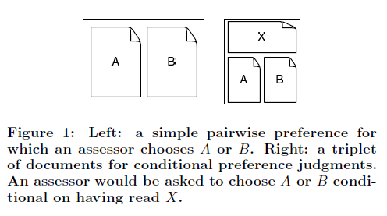
Preference Based framework
Preference judgements :
1. simple pairwise preference judgments
2. conditional preference judgments

Slide 8
Outline
Introduction
Preference Based framework
Preference-Based Evulation Measure
Experiments
Conclusion

Slide 9
Preference-Based Evaluation Measure
Browsing model
Documents utility
Utility accumulation
user scans documents down a ranked list one-by-one and stops at some rank k.

Slide 10
Preference-Based Evaluation Measure
Ex:
S : a set of previously ranked docuements
i=1,U(d1)
i=2,U(d2|d1)
i=3,F({U(d3|d2),U(d3|d1)})
i=4,F({U(d4|d3),U(d4|d2),U(d4|d1)})…...
Ex: U(d3|d2) = 9/10 , U(d3|d1) = 4/5
F() has two function:
Average: (0.9+0.8)/2 = 0.85
Minimum: min({0.9,0.8}) = 0.8

Slide 11
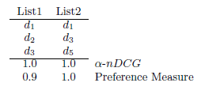
Preference-Based Evaluation Measure
K = 5,10,20
Final step: normalize

Slide 12
Outline
Introduction
Preference Based framework
Preference-Based Evulation Measure
Experiments
Conclusion

Slide 13
Data set
Use ClueWeb09 dataset(with English docuements)
A total of 150 queries have been developed and judged for the TREC Web track
Subtopic:3~8
Based on TREC profile

Slide 14
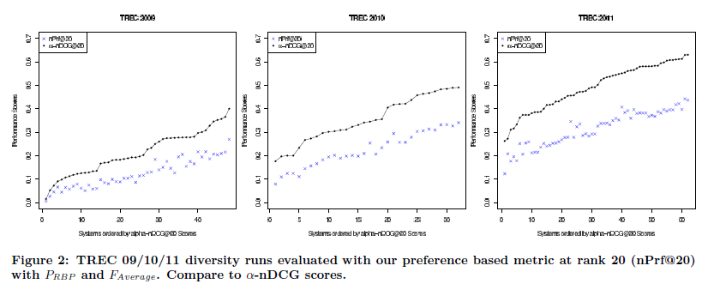
Analysis
System Ranking Comparison

Slide 15
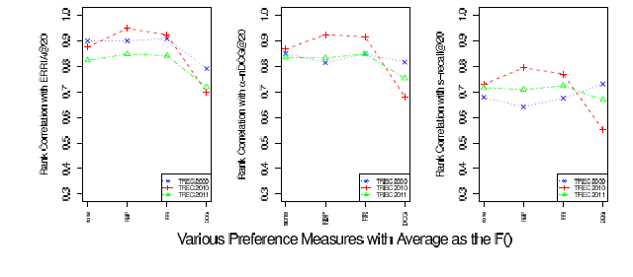
Analysis
Rank Correlation Between Measure

Slide 16
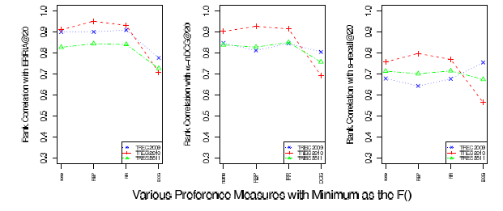
Analysis
Rank Correlation Between Measure

Slide 17
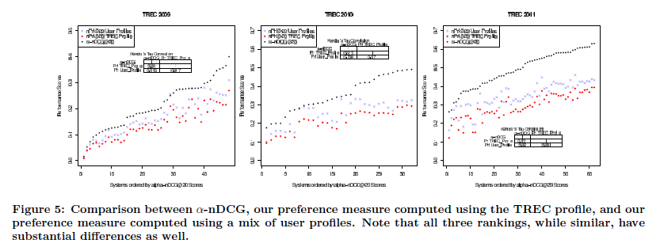
Analysis
Evaluation Multiple User Profiles

Slide 18
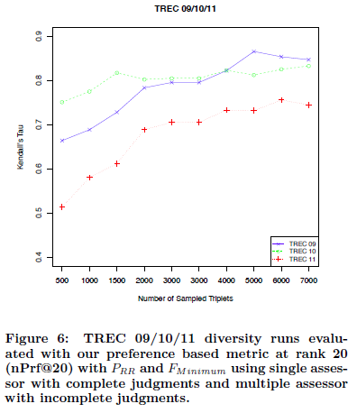
Analysis

Slide 19
conclusion

Slide 20
Conclusion
The author proposed a novel evaluation framwork and a family of measure for IR .
It can incorporate any property that influences user preferences for one document over another.

